Slide 1
Programming
With Mr. K

Slide 2
What we’re doing today
Who am I and what do I do?
What is coding and where is it used?
Examples of code
Hospital Exercise
Questions

Slide 3
Who am I?
Born in New York, moved here 5 years ago
Software Programmer for 13 years
I have a wife, a daughter and two dogs
I’ve been working on computers since I was 6 years old
Who can tell me what a software programmer does?

Slide 4
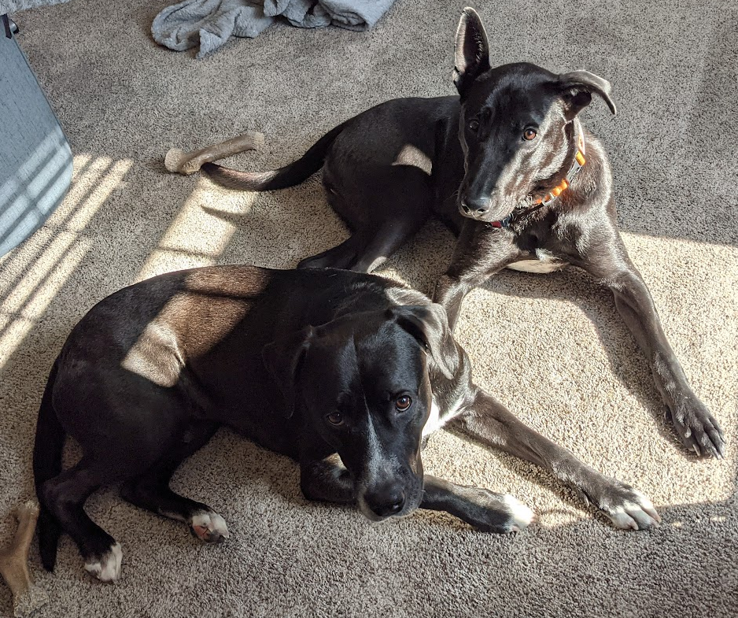
My Dogs

Slide 5
Who are you?
Let's do some polling!

Slide 6
What is coding?
It’s a way to give computers instructions to do things
We do this so that we can break down real life problems and automate it
Automation leads to faster and more consistent ways to do things
It can also do some things better than we can

Slide 7
Where is it used?
Everywhere!
Simple things like a calculator
Everyday things like your phones, cars, and TV
Entertainment industry (games, movies, etc.)
Complex things like rockets to get people to space or finding the cure for cancer

Slide 8
Why do I like it?
I can work in any field with the same set of skills
The field is always changing and there’s always something new to learn
There’s always hard new problems to solve. I like solving puzzles.
I love to help others and make a difference

Slide 9
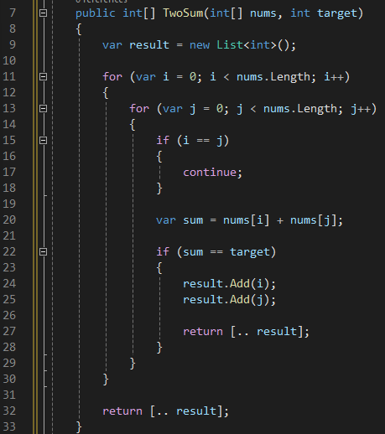
Code examples

Slide 10
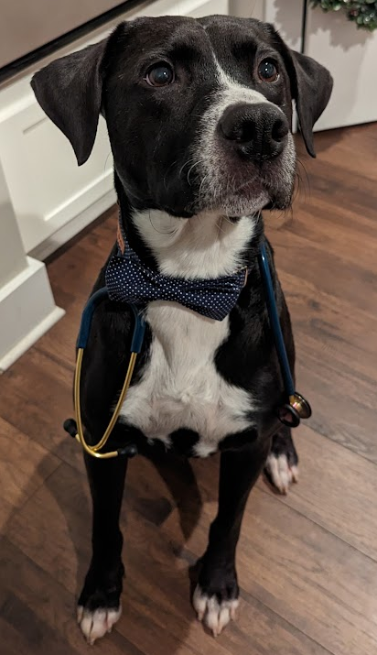
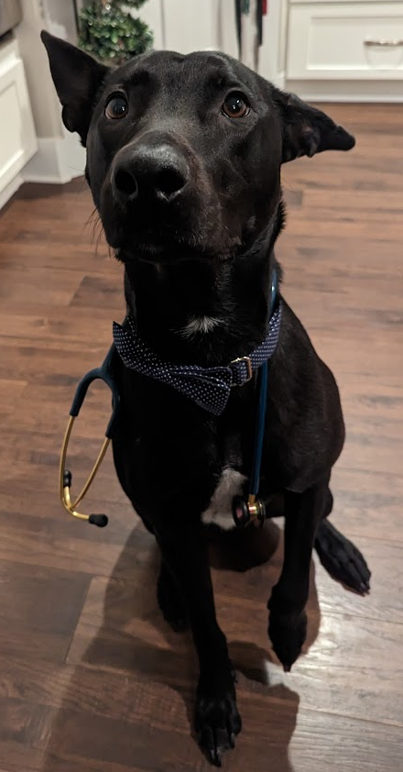
Hospital Exercise - Dogtors

Slide 11
Hospital Exercise
We’re going to try to help the dogtors schedule patients in a way that makes sure everyone is seen and helped when it matters.
There are two dogtors. They must see the most hurt patients first. If there are two equally hurt patients they have to see the patient who came in first.
How hurt they are is broken into three categories; Severity A, B, and C. Severity A is the most hurt and C is the least. Severity A patient takes the dogtor 30 minutes, B takes 15 minutes, and C takes 10 minutes to heal.

Slide 12
Hospital Exercise
We’ll do the first 3 together and you’ll do the last 8 in pairs.

Slide 13
Questions?

